Slide 1
UNIT - II
Cloud as a service:
Gamut of cloud solutions,
principal technologies,
cloud strategy,
cloud design and implementation using SOA,
Conceptual cloud model, cloud service defined
Cloud solutions:
Cloud ecosystem,
cloud business process management,
cloud service management,
cloud stack,
Computing on demand,
cloud sourcing.

Slide 2

Assume you want to host a birthday party..

Slide 3
Check list!!!!
Will you buy a land?
Will u construct a lawn or hall?
Will you go to market and buy stuffs?
Will you prepare the cake?
Than????

Slide 4
Best option is …
Book a hall
Hire a caterer
Order a cake
Any other option???
Hire a party organizer

Slide 5
So what does the organizer give
He gives you service of
Place
Food menu
Decorative stuffs
Etc etc…..
Organizer as a Service..

Slide 6
Same way if the service is given by cloud…
Infrastructure
Platform
Software
Its called Cloud as a Service……

Slide 7
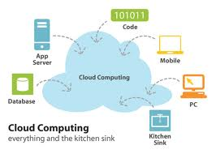
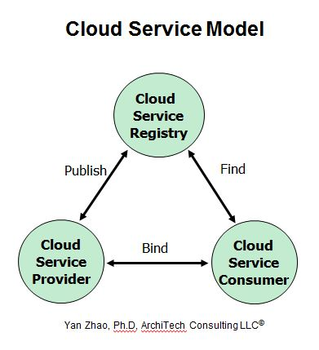
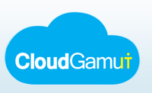
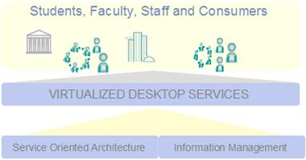
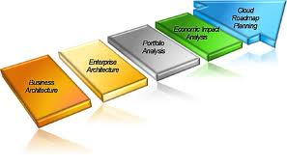
Cloud as a Service
Gamut of cloud solutions, principal technologies, cloud strategy, cloud design and implementation using SOA, Conceptual cloud model, cloud service demand.

Slide 8
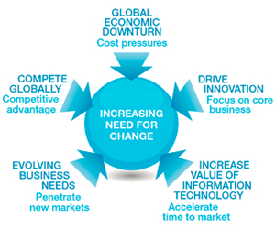


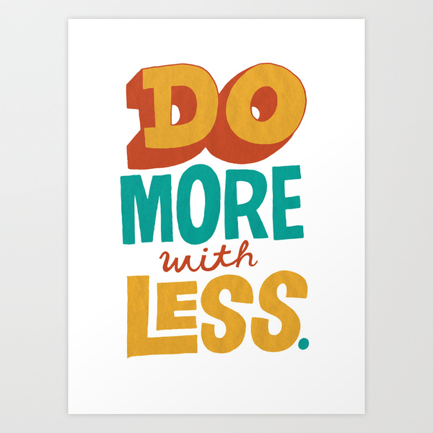
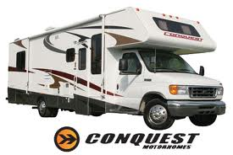
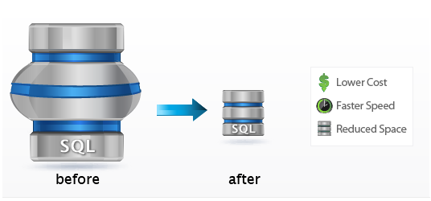

Introduction
In today's economy many businesses
are faced with challenges like:
"taking cost" out of their infrastructure
deliver new, innovative business services
"do more with less"
fast change their IT infrastructure
IT resource optimization and lowering cost
Add rental-style capability to IT resource usage

Slide 9
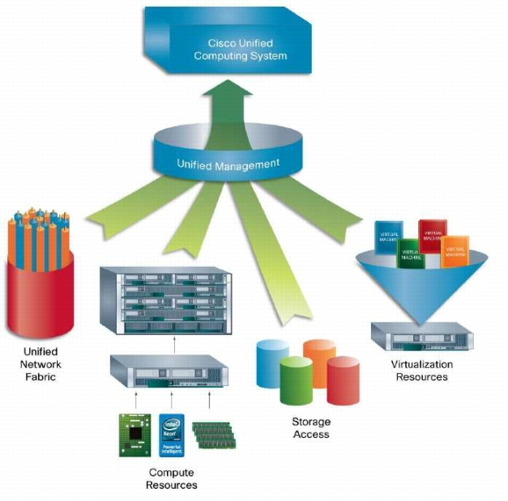
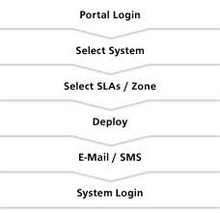
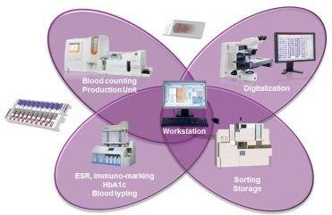
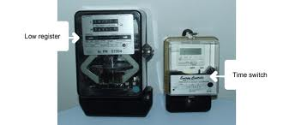
Cloud Computing defines new ways to:
Manage IT resources, thus enabling
self-service provisioning of IT resources
Metering-style accounting based on use/time
Automation of IT management

Slide 10
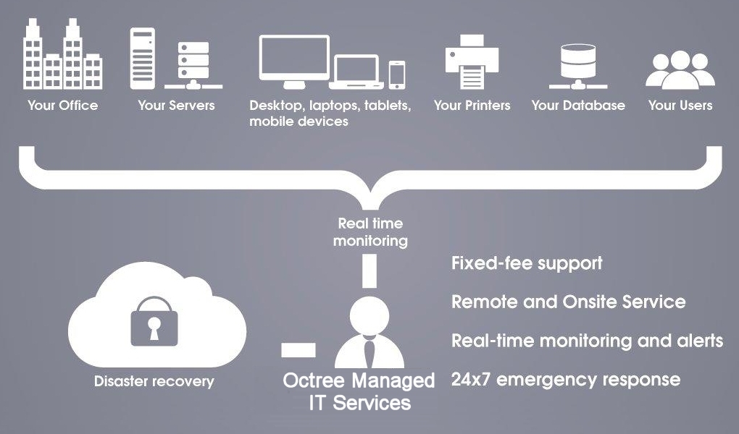
Manage IT resources

Slide 11
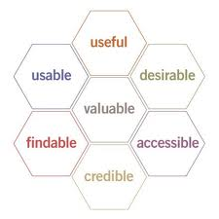
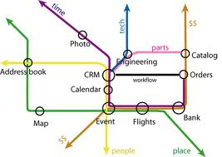
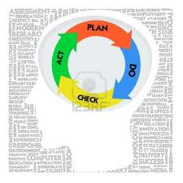
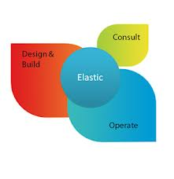
Cloud Computing is:......
User experience
Business Model
Emerging style of computing where
applications, data, IT resources are provided as services
Infrastructure management methodology
New way of managing large numbers of highly virtualized resources, such that from management perspective it resembles a single large resource.

Slide 12

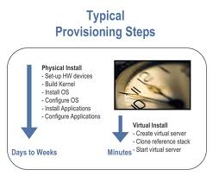

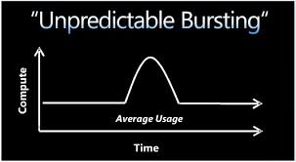
Common attributes of cloud infrastructure are:
Flexible pricing - utility pricing,
pay-by-consumption; subscription model
Elastic scaling - resources scale up and down as demand changes
Rapid provisioning - IT and network capacity are automatically and rapidly provisioned
Standardised offerings - uniform offerings are available from services catalogue on a metered basis

Slide 13
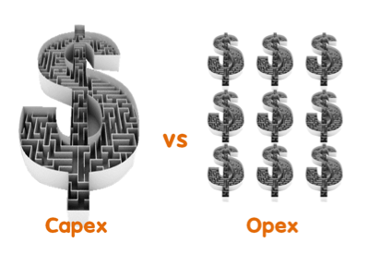
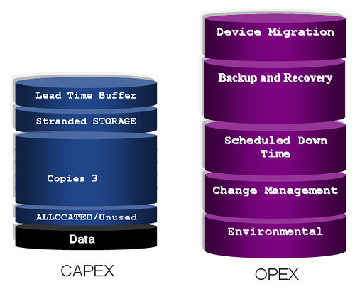
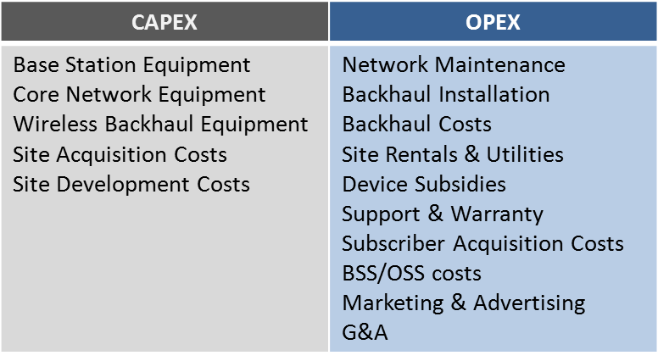
Two primary levers to achieve cost optimization:
Operating Expense - Op-ex
Capital Expense - Cap-ex
Strike right balance between Op-ex and Cap-ex.

Slide 14



Cloud Types and "as a service"
- Just completely outsource it and buy it as a service:
A practice used by different companies to reduce costs by transferring portions of work to outside suppliers rather than completing it internally.
Infrastructure as a service
Computer power, storage, file system as a service
Platform as a service
Middleware, Google app engine
Software as a service –
CRM, e –commerce, app
Business process as service
Possible because of - Virtualization, Standardization and Automation.

Slide 15

Cloud computing introduces the concept of "IT-as-a-service".
To support this, the cloud infrastructure must deliver:
Abstraction - Allow end-users to focus on execution of high -value activities than on operation of applications.
Virtualization - Location independent and no constraint on resources
Dynamic Allocation - Dynamically provision, configure, reconfigure and de-provision IT capability
Data Management - Fast, Secure, Reliable data access with integrated data protection and recovery management.

Slide 16
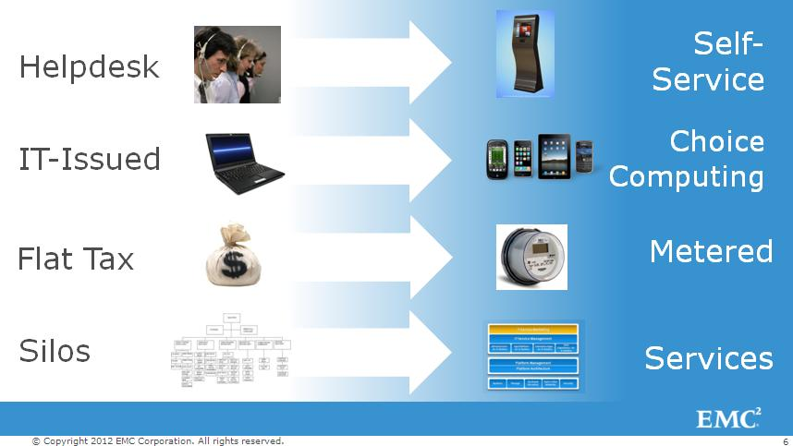
It-as-Service

Slide 17
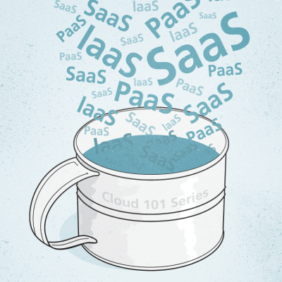
3.2 Gamut of Cloud Solutions
There are 5 commonly used categories in
a spectrum of cloud offerings:
Platform-as-a-service (PaaS) -Provision H/W, OS, Framework, Database
Software-as-a-service (SaaS) - Provision H/W, OS, Special purpose S/W
Infrastructure-as-a-service (IaaS) - Provision H/W and organization has control over OS
Storage-as-a-service (SaaS) - Provision of DB-like services, metered like - per gigabyte/month
Desktop-as-a-service (DaaS) - Provision of Desktop environment within a browser

Slide 18
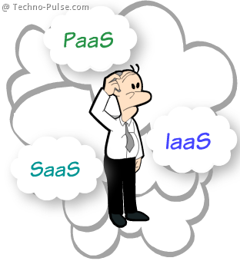
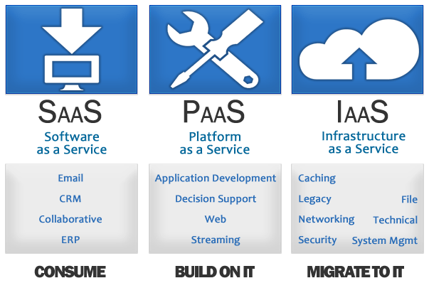
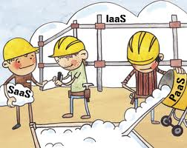

Slide 19
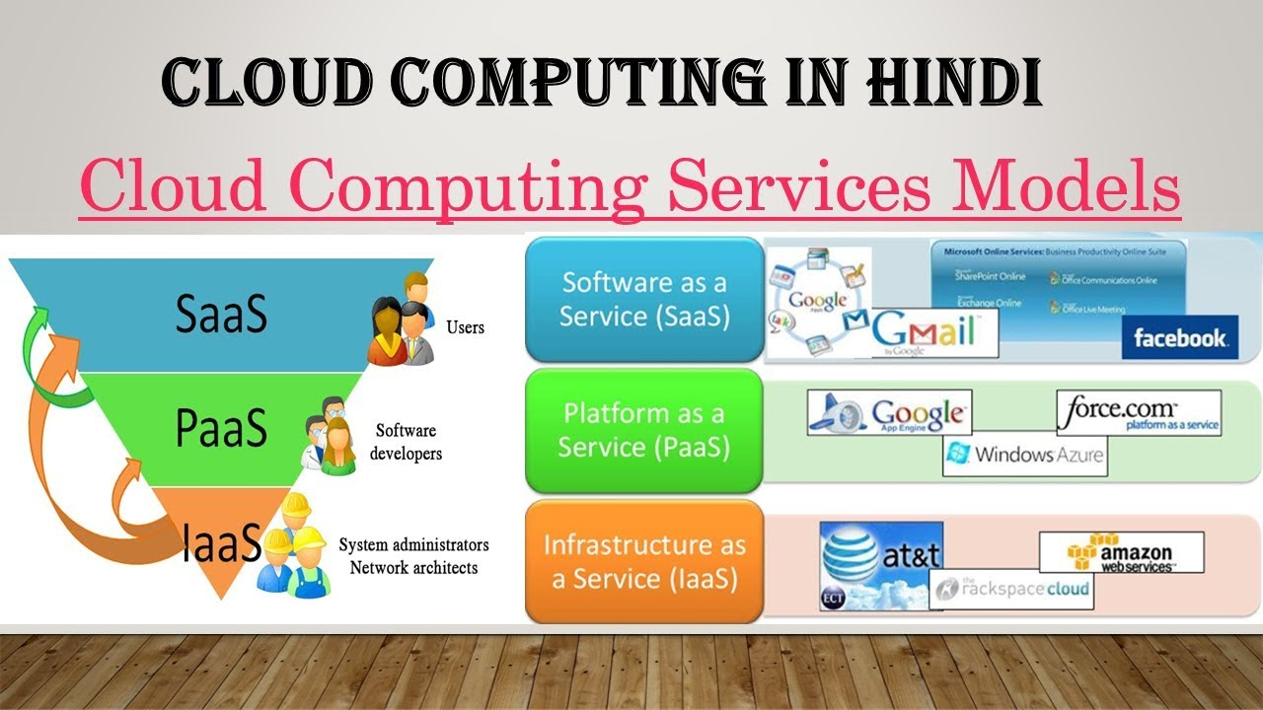
Example of SaaS, PaaS & IaaS

Slide 20
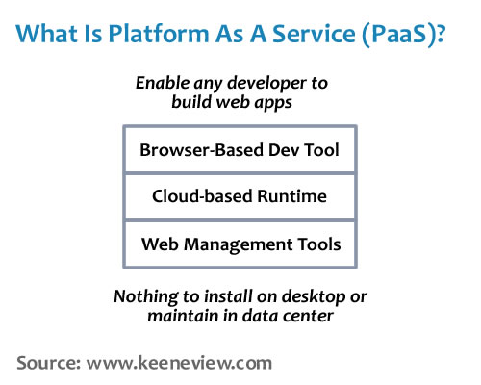
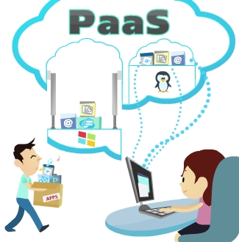
3.2.1 Platform as a service

Slide 21
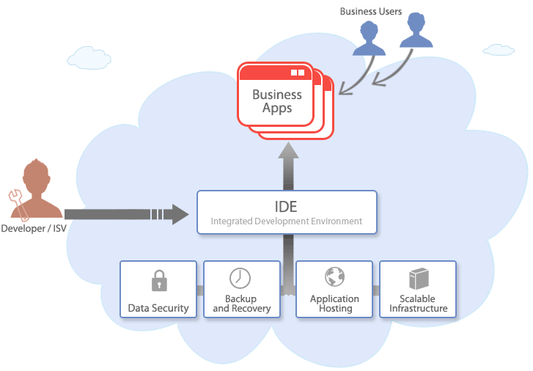
3.2.1 Platform as a service
Provide the foundation to build highly scalable and robust web-based applications - IDE like
Catalogue of virtual images and patterns (cluster of servers working together) ready for immediate use, are given
PaaS saves costs by
Reducing upfront software licensing cost
Reducing infrastructure costs
Reducing operational cost for development, testing and hosting environment

Slide 22
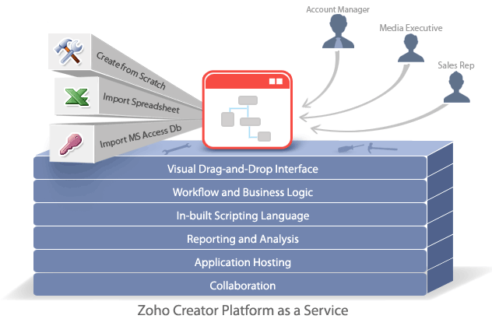
3.2.1 Platform as a service - cntd
PaaS improves development productivity by
Removing all challenges of integration with services like DB, middleware, web framework, security etc
Software development and delivery times are shortened
No need to have separate development and test environments
Simplifies s/w project management
Fosters collaboration among developers

Slide 23
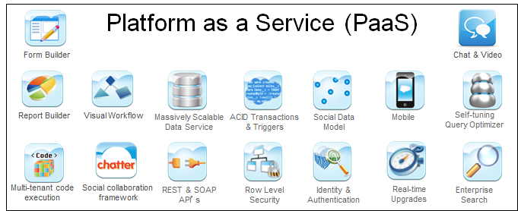
PaaS provides a software development environment that enables rapid deployment of new applications

Slide 24
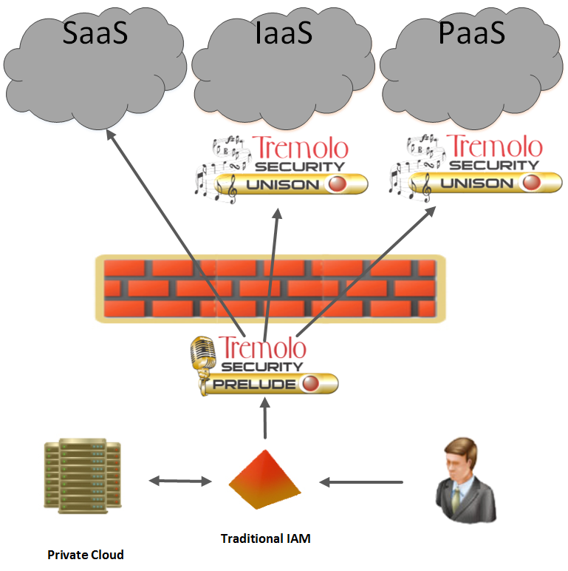
PaaS offerings lack the functionality needed for converting legacy applications to full fledged cloud services

Slide 25
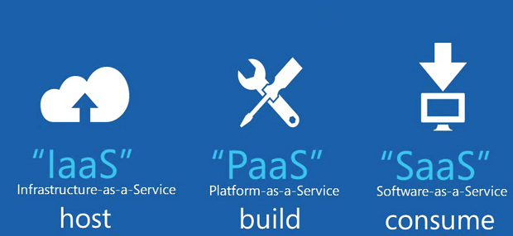

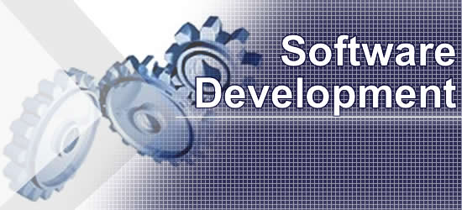
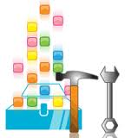
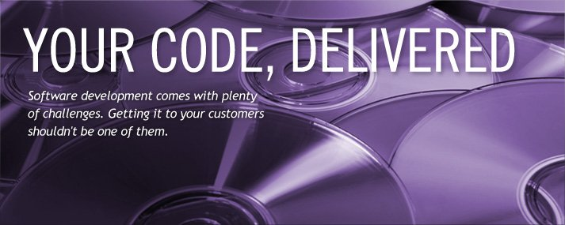

3.2.2 Software-as-a-service
SaaS is intended to simplify the provision of specific business services.
SaaS saves cost by:
Removing the effort of development
Removing the effort of maintenance
Removing the effort of delivery of S/W
Eliminating up-front software licensing & infrastructure cost
Reducing ongoing operational cost for support, maintenance and administration.

Slide 26
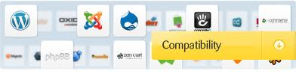
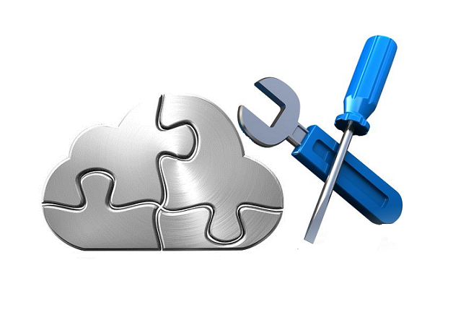

3.2.2 Software-as-a-service
NOT SUITABLE:
Applications that require extensive customization are not good candidates for SaaS
Complex core business applications
Compatibility problems as SaaS provides only one version of the software platform

Slide 27
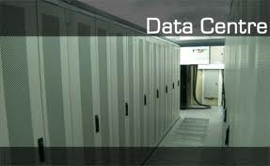
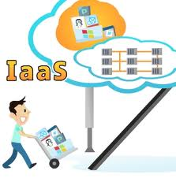
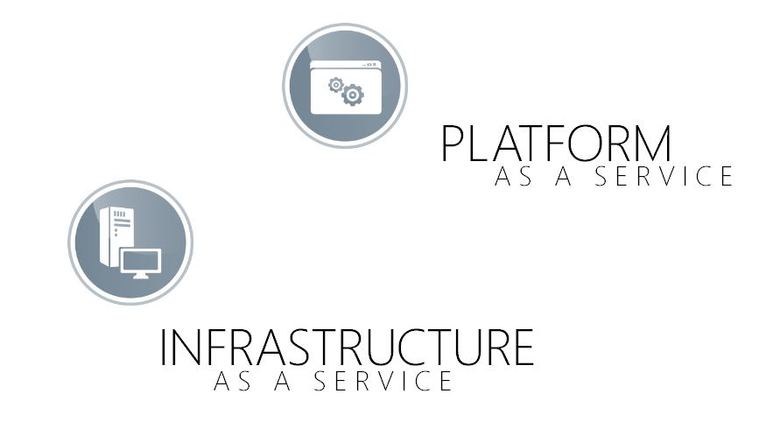

3.2.3 Infrastructure-as-a-service
IaaS saves cost by reducing capital expenditures (Cap-ex) on infrastructure and ongoing operational cost (Op-ex) for support, maintenance and administration.
Organizations can massively increase their datacentre resources without significantly increasing the number of people needed to support it.
Ex:

Slide 28
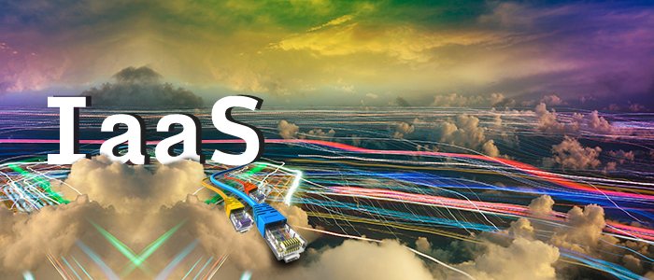
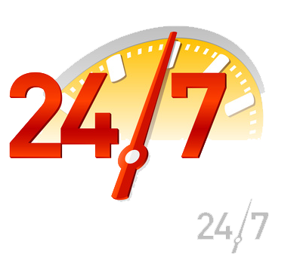
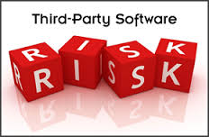
3.2.3 Infrastructure-as-a-service
IaaS resources are leased on a pay-as-you-go basis, according to hours of usage.
IaaS NOT SUITABLE:
Applications that need to run 24/7
Applications that needs integration with 3rd party software
Applications without cloud licensing model

Slide 29
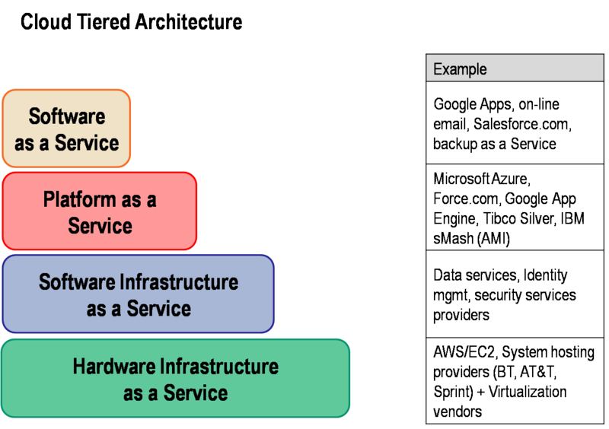
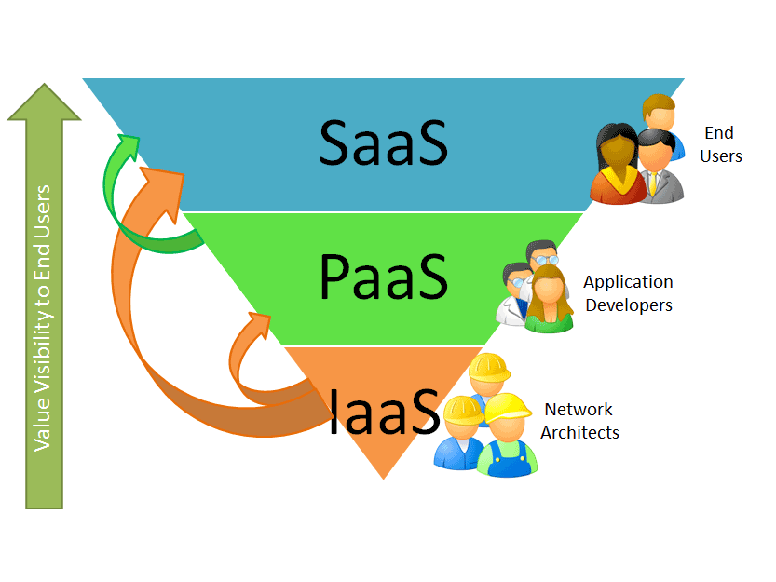
SaaS is considered to be more mature than IaaS and PaaS.

Slide 30
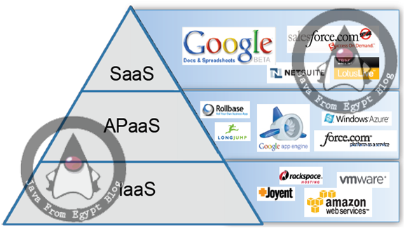

Slide 31


3.3 Principal Technologies
The key to being able to provide dynamic cloud infrastructure is the virtualization layer that sits between the cloud instances and the physical hardware it runs on.
The platform virtualization software - hypervisor - allows multiple operating system instances to run as guests on the same server.

Slide 32


Slide 33




The main drivers for cloud computing are cost, agility and time-to-market. Able to move quickly and easily:
The cloud orchestrator and provisioning engine, is a layer of software that
Interacts with multiple servers
Enables IT dept to pool resources
together across server
Defines standardised tiers of services called virtual compute centres

Slide 34

Cloud orchestrator and provisioning engine:
Using this IT departments can share underlying cloud infrastructure in a secure multi-tenant manner.
Using this, standard collection of VMs can be made and policies on how to use these can be set
This removes IT involvement in infrastructure-enabling work.

Slide 35

3.4 Cloud Strategy
The key steps in cloud implementation planning are as follows:
Understand cloud strategy
Define cloud application requirements
Assess cloud readiness
Define high-level cloud architecture
Identifying change management requirements
Develop roadmap and implementation plan.

Slide 36
This helps to deploy the cloud deployment with following benefits:
Reduced risk and faster deployment
It leverages vendor assets and skills
Improve Service
Helps in migrating cloud to achieve business
Lower cost
Opportunities to reduce capital and operating expenses.

Slide 37


3.5 Cloud Design and Implementation Using SOA
SOA is a very useful architectural style for implementing applications in the cloud.
Service-oriented architecture (SOA) is a software design and software architecture design pattern based on structured collections of discrete software modules, known as services, that collectively provide the complete functionality of a large software application
A cloud-based application consists of many granular coarse-grained services offered on the cloud.

Slide 38

3.6 Conceptual Cloud Model
The conceptual cloud model
describes the structure of the
cloud-based services as a
system in terms of its software
components with their
responsibilities, interfaces,
relationships and the way
they collaborate to deliver the
required functionality.

Slide 39

The conceptual component model has below offerings:
High-level service components that form the services provided by the offerings
The resources that support the cloud services
The technical components that provide the technical underpinnings of the cloud service
External and Internal services that are leveraged by the cloud application services

Slide 40


Slide 41

The cloud conceptual component model should contain the following elements:
The conceptual structure of the cloud application
The dynamic interactions and dependencies between various conceptual components
The components that comprise the cloud services provided by the application

Slide 42



3.6.1 Cloud Application Security and Privacy Principles
These contain the high-level guidance to cover security and privacy characteristics.
In addition to the elements of existing enterprise security program, the following areas tend to change as a part of moving towards cloud environment:
Governance
Authentication and Access Control
Data Protection
Logging and Alerting

Slide 43





3.6.2
With the move to the cloud infrastructure, with different network, additional administrators, often from external vendors requires change in:
Governance - For decisions on SLA
Authentication and Access Control - Additional support to the existing methods to suit the cloud environment
Data Protection - Require changes to the existing methods of data protection (disclosure or modification) as we move to the virtualised storage.
Logging and Alerting -
Logging - ability to tie actions to an individual
Alerting - Recognise malicious acts and bring
them to notice of the concerned.

Slide 44

3.7 Cloud Service Defined
This section highlights the aspects of service, its scope, and cloud-based different platforms integration and deployment services:

Slide 45

3.7.1 Services Definition
Service:
A specific IT deliverable that provides customer value.
It is measurable
It provides a basis for doing business with the customer
It is delivered through a series of processes and/or activities

Slide 46

3.7.1 Services Definition
Services Portfolio:
A collection of services provided by IT, that in their aggregation represents all the 'value addition' activities performed by IT.

Slide 47

3.7.1 Services Definition
Service Component:
A logically grouped set of activities that represent part of a service that touches the customer.

Slide 48

3.7.1 Services Definition
Service Owner:
The individual accountable for ensuring the customer receives the identified value of the service.

Slide 49

3.7.1 Services Definition
Process:
A collection of related activities that take inputs, transforms them, and produces outputs that support an enterprise goal.

Slide 50


3.7.1 Services Definition
Enablers:
The decomposed components of a service (process, organization, technology) that are combined to create service deliverables.
The collection of activities become the workflow needed for Service Delivery.

Slide 51


3.7.1 Services Definition
Service Level Agreements:
A grouping of services or service components that have had specific delivery commitments and roles identified with the customer.

Slide 52


3.7.1 Services Definition
Service Level Management:
SLM governs the planning, coordinating, drafting, agreeing, monitoring, and reporting on Service Level Agreements and ensures that and cost-justifiable service quality is agreed to, maintained or where necessary improved.

Slide 53


3.7.1 Services Definition
Service Level Management Objectives:
To maintain and improve IT service quality, through a constant cycle of agreeing, monitoring and reporting upon IT service achievements.
To eradicate poor service.
Helps to develop a better relationship between IT and its customer.

Slide 54

Services - In brief
Something that makes sense as a customer / user selectable item, with corresponding service requests available in a menu or service catalogue.

Slide 55
3.7.2 Services Scope Overview
Platform Integration and Deployment Services
Software Platform Management Services

Slide 56



3.7.2 Services Scope Overview
Platform Integration and Deployment Services
These provide a set of project services for the
planning,
design,
procurement,
assembly and integration,
site installation and project management of the deployment mainstream and
special purpose end user services...
It integrates and customizes multiple devices:
Wireless & mobile devices
PCs,
Kiosks
ATMs
Point-Of-Sale devices and printers

Slide 57

3.7.2 Services Scope Overview
Software Platform Management Services
It provides a set of project and annuity services to manage end-user software platforms, including:
Image development & management
Application software packaging & distribution
Servers to manage the availability of the end-user platform proactively.
Services to manage the availability of the end-user platform, includes services to design and migrate end-user platform say for ex: Microsoft XP to Vista.

Slide 58


3.7.3 Platform Integration and Deployment Component Services
This section discusses some of the very important platform integration and deployment services:
Order Management - Procurement of H/W, S/W
Warehousing and Stock Management - Store H/W
Platform Build & Test - Services to build, integrate, customize, prepare and test the H/W and S/W platform
Base Backup - Backup to be taken during platform pre-build.
Data and Personality Migration - Migrate data & personality settings (wallpaper, layout etc) to the replacement platform.

Slide 59
cntd
Asset Tagging & Custom labelling - Custom asset tagging of H/W components
Asset Inventory Update and Report - Adding new asset to customers or managed DB
Logistics & Delivery: Packaging & shipment to the site of the user H/W platform.
Installation - Deployment of the platform into the customer's operational environment
Extended Project Management - Extends the PM scope to cover overall management of the platform deployment program, including customers' 3rd party activities and resources

Slide 60
cntd
Platform Removal and Return - Decommission of platform from customer location and return to cloud vendors for refurbishment or disposal.
Asset Refurbishment - Checks for suitability of the H/W platform, refurbishment and upgrade as appropriate.
Asset and Data Disposal - Removal of sensitive data from H/W platform, and safe environmental disposal.
Emergency Replacement - H/W platform
Software Platform Management Services -

Slide 61
cntd
Software Platform Design Consulting - Business and technology needs for a new S/W platform
Software Platform Creation and Customization - create and test a s/w platform to support the needs of business.
Software Platform Support and Maintenance- Ongoing support & maintenance of s/w platform, including updates, management etc
Application Scripting - Creation of s/w installation scripts to accommodate customer environment

Slide 62
cntd
Application Discovery - Discover what applications are in-use across organization
Application Portfolio Management - Help clients manage their application portfolio
Software Delivery - Schedule and transport application packages to target end-points
Anti-Virus Management -Services to manage the delivery of antivirus signature files
Patch Management -Ensure that end-users have latest patch releases
Health Check Services - Good state of health of the system like infrastructure and PC checks.

Slide 63



cntd
Compliance Services - To ensure end-users are compliant with client standards.
External Services - Services visible by customer, include - Business Intelligence, Logistics, Receiving Orders, Marketing Services, Invoicing, Accounting etc
Internal Services - Services invisible to customer, mainly infrastructure services - include- hosting services, storage, availability, data retention or recovery etc.

Slide 64


cntd
User- Initiated Service Request -
Customer-Initiated Service Request
- A Service Catalogue-Based Request:

Slide 65

Thanks to -
1) Dr. Kumar Saurabh
2) http://cloudcomputing4postgraduates.blogspot.in/
3) Google Images

